Slide 1





How can the MindMate website help you?
Notes:
FOR PRESENTER (not to read out): The aim of the presentation is to raise awareness of MM website and Instagram account and show the variety of content, to make it appealing and relevant for young people. We haven’t included details about individual services so that it remains up to date, but you can find this information on MindMate if you want to pick a particular service to share about as part of this presentation. You can find information about more resources to promote MindMate in your school here - How to run a MindMate promotion in your school - MindMate
Script to accompany presentation:
We’re going to talk about the MindMate website – hopefully many of you will have heard about it already, but you might not realise how much different content is available…

Slide 2



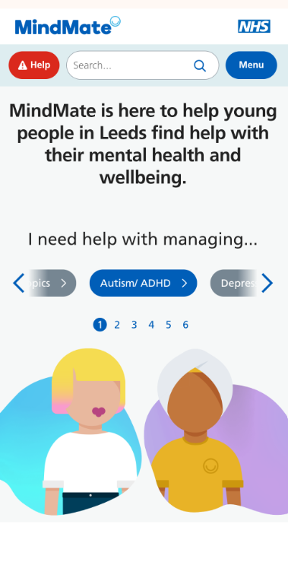


Getting help
Neurodiversity hub
Self-help and wellbeing
Coping with common issues
Notes:
The MindMate website is an information hub for Leeds, and includes:
free services available in the city
Self help ideas to help you look after your wellbeing
advice and information on a range of mental health issues
Lots of information related to neurodiversity

Slide 3
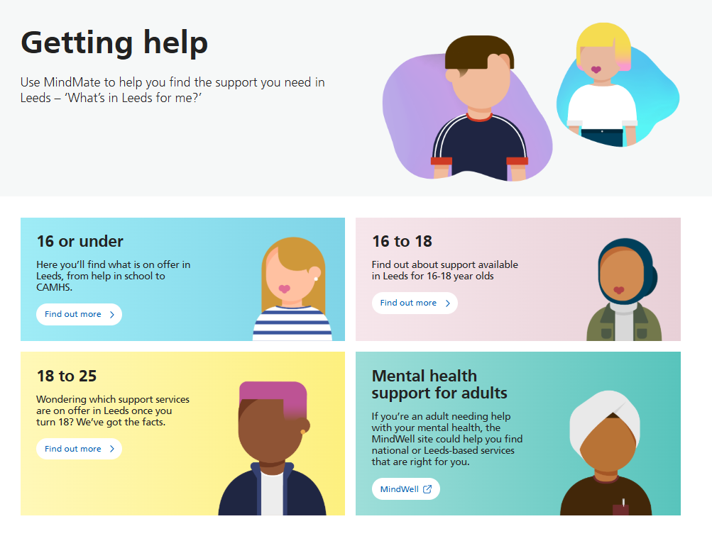
Notes:
Use MindMate to help you find the support you need in Leeds – it’s broken down into different age groups so you can find services that are suitable for you

Slide 4

Notes:
There are lots of ways to get support for your mental health – whether you want to talk to someone in person, or anonymously by phone or online chat.

Slide 5
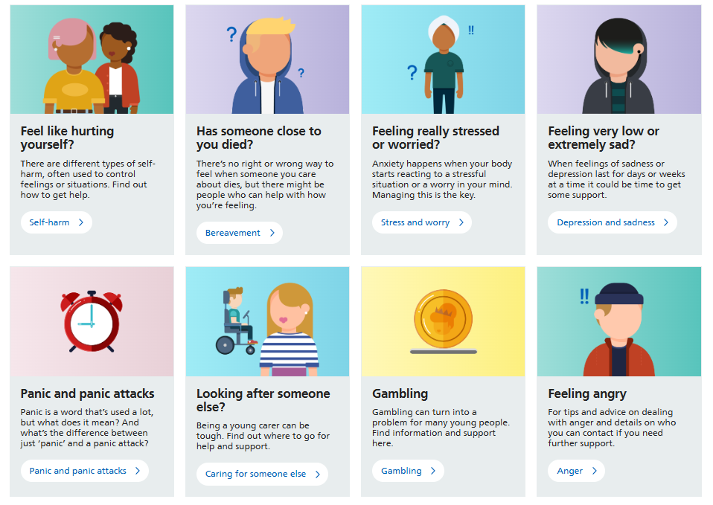
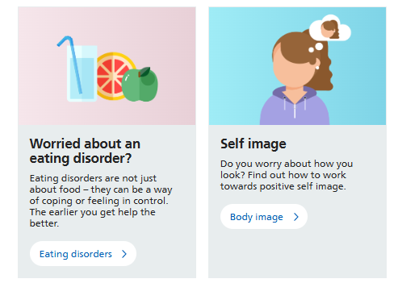
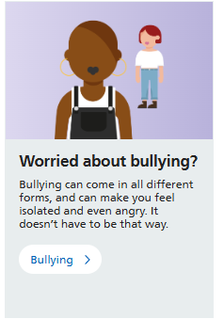
Notes:
There is also lots of content on MindMate about different topics or mental health challenges… it’s all been written by or checked by professionals in Leeds so it’s information you can trust.

Slide 6
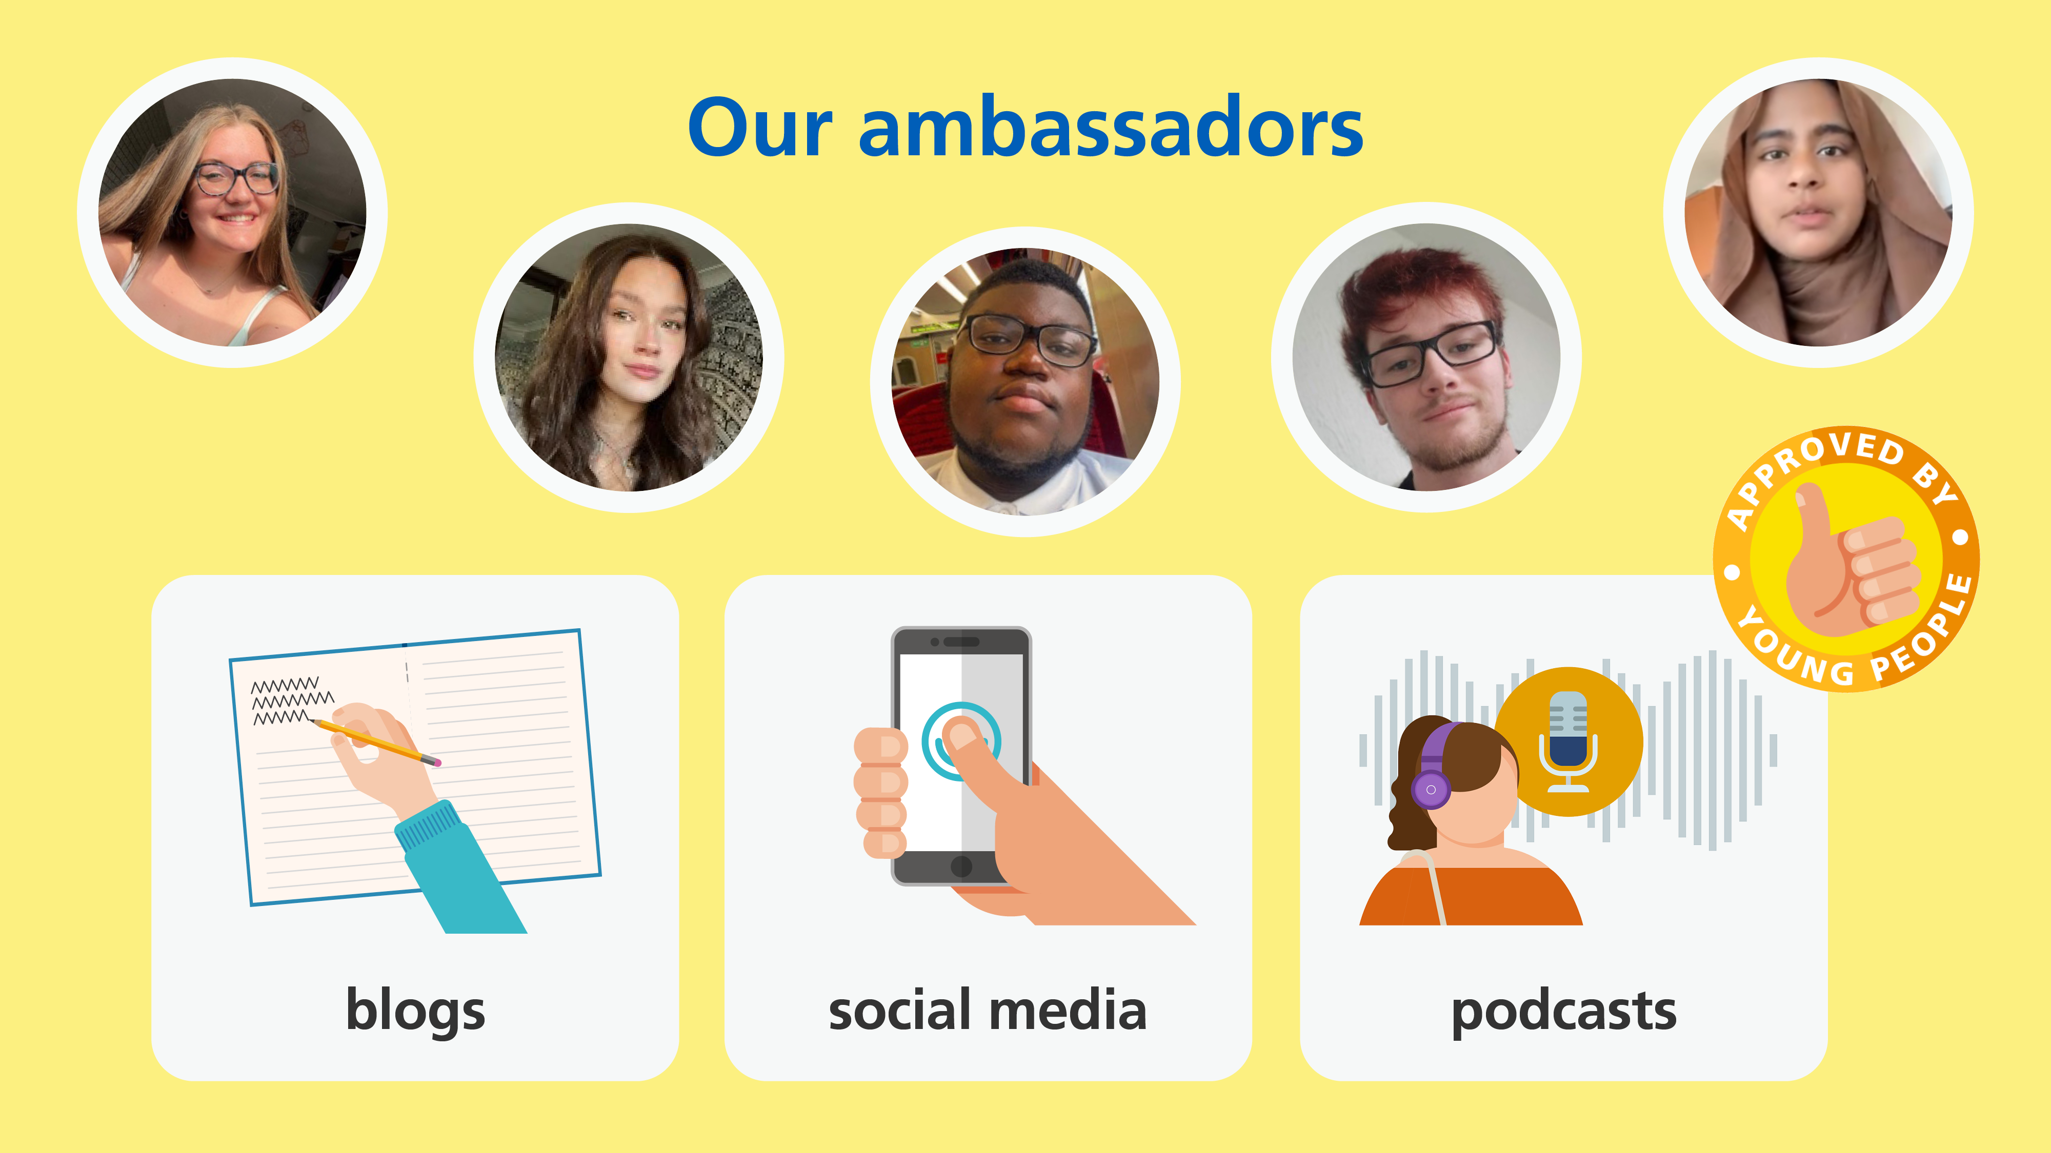
Notes:
Also a big part of MindMate is about giving young people in Leeds a space to share about their own thoughts and experiences of mental health.
You can read blogs and listen to podcasts, many of which are written and recorded by our MindMate Ambassadors – you can see some of the current ones on the screen.
If you’re interested in getting involved there’s a link online to get in touch with the team who create the content.

Slide 7

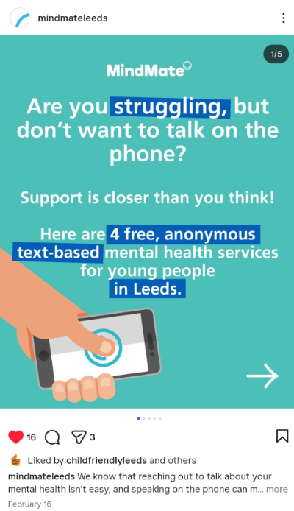
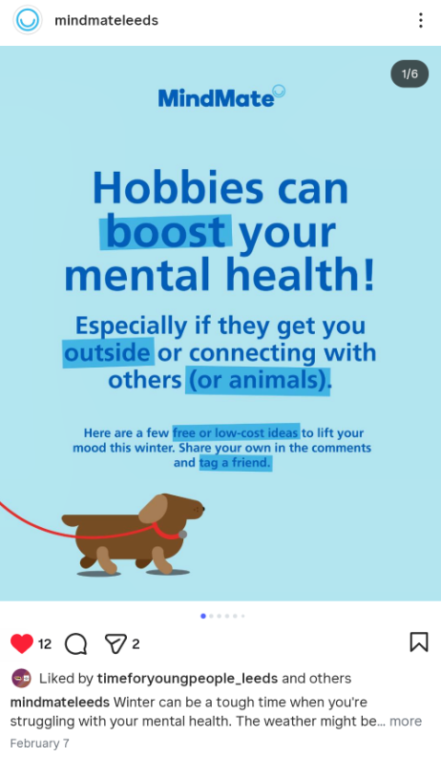
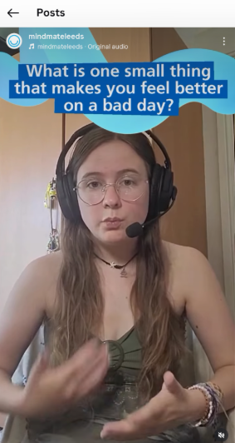
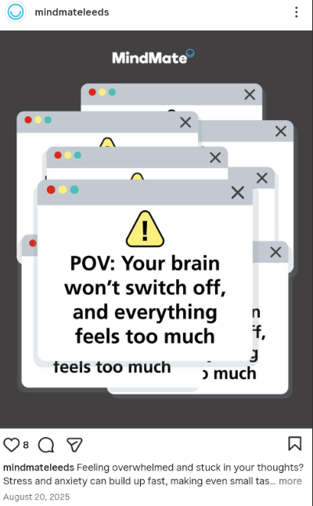
@mindmateleeds
Notes:
If you’re old enough, and you have an Instagram account – you can also follow the MindMate account for great content about mental health in Leeds

Slide 8
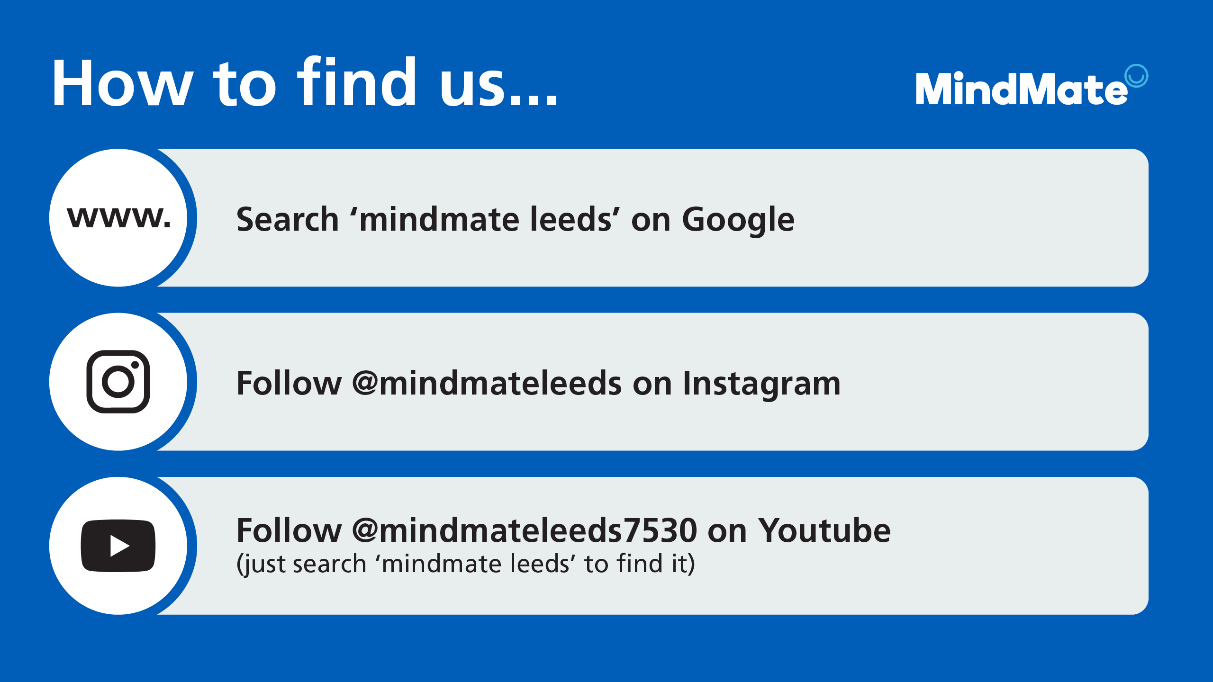
Notes:
Here are the details to find the website and social media accounts…

